Slide 1
Overhead Cost Controlling

Slide 2
Objectives
To gain understanding of key business processes of SAP Overhead Cost Management (OCM)

Slide 3
SAP Overview
SAP Overhead Cost Management

Slide 4

SAP Modules - Overview
Overhead
Cost
Management
SD
FI
Sales &
Distribution
Financial
Accounting
MM
CO
Materials
Mgmt.
Controlling
PP
AM
Product
Planning
Fixed Asset
Mgmt.
SAP R/3
QM
PS
Quality
Mgmt.
Project
System
PM
OC
Plant Maint.
Office &
Comm.
HR
IS
Human
Resources
Industry
Solutions

Slide 5
Correlations in Accounting
Subsidiary Ledger
SAP SEM / SAP BW
Controlling
  Cost center
  Internal order
  Project system
  Profitability analysis
  Profit Center Accounting
Consolidation
Customer
General Ledger
Vendor
Special Purpose Ledger
  Special evaluations
  Parallel reporting
  Joint Venture Accounting
Human
Resources
Fixed
Assets
Material
Cash Management
  Cash management position
  Liquidity forecast
Document Database

Slide 6


CO Components
CO
Operating concern (9100 – A group)
Profitability
EC
-
PA
segment
PCA
Profitability Analysis
Profitability Analysis
CO
OM
Overhead Cost Controlling
Product Cost
Controlling
Cost centers
Internal
orders
CO Production
Order
Controlling area (9100 – A group)
Internal Orders
Profit Center Accounting
Activity
types
Standard
Cost Estimate
CO
CEL
Cost Element Accounting
Cost Element Accounting
FI
Financial
Asset
Revenues
Accounting
Expense
Company Code (9100 A Ltd, 9200 A1 Ltd)
Financial
Accounting
Human
Materials
HR
MM
Materials
SD
Sales and
Resources
Management
S&D
Management
Distribution

Slide 7


Overhead Cost Management
The Overhead Cost Controlling component (CO-OM) helps you to plan, allocate, control, and monitor overhead in your organization
By planning in overhead areas, you can develop standards, that allow you to control costs and valuate internal activities.
  Cost Centre Accounting
    Cost Center Accounting analyzes where overhead occurs within the organization
    Costs are assigned to the sub-areas of the organization where they originated.
    SAP offers a wide variety of methods for allocating posted amounts and quantities.
  Internal Order Accounting
    Internal Orders collect and analyze costs based on individual internal jobs.
    SAP can monitor and automatically check budgets assigned to each job.

Slide 8







Overhead Cost Management
Cost Element Accounting
Cost Center Accounting
✓
Cost Elements
Reconcilation with FI
Hierarchies
Cost Centers
Stat. Key Figures
Activity Types
✓
Resource Planning
Multiple Currency
Multiple Valuation
Analyze of Plan/ Target/Actual Costs
Internal Orders
✓
Internal Orders
Orders

Slide 9
OCM Processes
SAP Overhead Cost Management

Slide 10
OCM Process Overview
Process decompositions are the starting point for process documentation.
They summarise what is involved in the OCM process at a high level
Controlling
Cost Centre Accounting
Master
Data
Planning
Actual Posting
Period End Closing
Reporting

Slide 11
OCM Processes
Master
Data
Planning
Actual Posting
Period End Closing
Reporting
Cost Element
Cost Centre
Activity Type
Resource
Statistical Key Figures
Internal order
Groups
Planning preparation
Cost Centre Planning
Internal Order Planning
Plan cost distribution
Plan cost assessment
Plan direct activity allocation
Plan indirect activity allocation
Plan settlement of overhead cost orders
Other planning activities
Manual entries
SKF entry
Direct activity allocation
Indirect activity allocation
Order budget
Reposting
Actual Cost distribution
Actual Cost Assessment
Cost Splitting
Calculate Actual Activity Prices
Settlement of Overhead Orders
Manual Cost Allocation
FICO Reconciliation

Slide 12
Master Data
SAP Overhead Cost Management

Slide 13
Organizational Units & Master Data
Operating Concern
A Grp Operating
Concern (9100)
Controlling Area
A Grp Controlling
Area (1000)
Profit Centers
Ethylene
Propylene
Pharma
Polyolefins
Power
Telecommunication
Information technology
Corporate
common
Company Codes
A Ltd
9100
A1 Ltd
9200
HQ
1000
Cost Centers
Purchasing
13…
Gen
Services
14…
Sales and
Marketing
15…
R & T
16…
Other Cost Objects
Orders
Cost Objects

Slide 14
Cost Element
Description
A cost element classifies the organization's valuated consumption of production factors within a controlling area
Primary Element - costs that originate outside the company; relate directly to the income statement in FI and must be included in the FI Chart of Accounts
Secondary Element - costs that result from internal allocation activities; NO relation to G/L accounts in FI. These accounts are exclusively for cost accounting and are only maintained in CO

Slide 15
Cost Element vs GL Account
Financial
Accounting
Controlling
Chart of Accounts
Balance
Sheet
Accounts
Cost Centre Accounting
Internal Orders
Product Costing
Profitability Analysis
All primary
cost elements
linked to
Income Statement
Accounts
Adjustment
Accounts
No Balance
Sheet
Accounts in
Controlling
Cost Elements
Income
Statement
Accounts
Primary
Cost
Elements
No Secondary
Cost Elements
In Financial
Accounting
General Ledger
Accounts Payable
Accounts Receivable
Fixed Assets
Treasury
Secondary
Cost
Elements

Slide 16
Cost Centre
Description
Organizational unit within a controlling area that represents a defined location of cost incurrence. The definition can be based on:
  Functional requirements
  Allocation criteria
  Physical location
  Responsibility for costs
Defines the smallest area of responsibility within the company that causes and influences costs; the lowest level to which you can meaningfully assign direct and indirect costs

Slide 17
Cost Centre Standard Hierarchy
Enterprise
Company
Functional Area
Cost Center
A group
Standard
Hierarchy
A Ltd
9100
xx01 - Production
9101000 – Production Common
xx02 - Maintenance
9101011 – EG- 1 Plant
xx03 - Utilities
xx04 – Engineering & Projects
A1 Ltd
9200
xx05 – Quality Assurance
xx06 – Production Planning
xx07 – Production Handling
xx08 –Warehousing & Storage
A11 Ltd
9300
xx09 –Executive Office
xx10 - Finance
9110000 – Finance
xx11 – Human Resources
9111000 – Human Resources
Nodes
A111 Ltd
9400
xx12 – Information Technology
9111001 – Housing Services
xx13 - Purchasing
9111002 – Training Centre
xx14 – General Services
xx15 – Safety & Security
xx16 – Sales & Marketing
Cost Objects
xx17 – Research & Technology
xx18 – Company General

Slide 18
Activity Type
Description
Unit in a controlling area that classifies the activities performed in a cost centre, e.g. maintenance hours for a maintenance cost centre
Used in activity allocation process

Slide 19
Statistical Key Figure
Description
Used to track quantities and values for various operating activities
Designed to be used in reporting and analysis
Used to assist in the allocation of costs throughout the OCM environment

Slide 20
Internal Order
Description
Used to plan, collect and settle the costs of internal jobs and tasks.
Internal orders are categorized as either:
  Orders used purely to monitor objects within Cost Accounting (such as advertising, training, or trade fair orders) and
  Productive orders that are value-added, that is, orders that can be capitalized (such as in-house construction of an assembly line).

Slide 21
Groups
Description
OCM master data can be grouped together, for example
  Cost Centre Groups
  Cost Element Groups
  Activity Type Groups
  Statistical Key Figure groups
  Internal Order Groups
Master data groups are used in reporting, planning, allocation, etc.
You can divide complex groups into manageable sections by separating them into sub-groups
You can create and maintain sub-groups separately and then combine them in larger groups

Slide 22
Actual Posting
SAP Overhead Cost Management

Slide 23
Manual Entries
Description
Actual cost entry enables you to monitor and trace costs incurred by your company as they arise. This allows you to identify variances quickly and take appropriate action to deal with them.
Actual cost entry involves transferring the primary costs recorded in Financial Accounting (FI) to the Controlling (CO) application component. In the CO component, this transfer occurs real-time from the components FI, MM, and AM, whereby a cost accounting object is recorded during account assignment
Process
Incorporated into other processes, e.g. FI Journal Entry, Goods Issue, etc

Slide 24
Manual Entries
Primary postings include the following transactions
  Payroll
  Material Usage
  Travel
  Purchase Requisition / Purchase Order / Goods Receipt / Invoice
  Inter / Intra Accounting Journals
  Depreciation

Slide 25
Manual Entries
Subsidiary Ledger
SAP SEM / SAP BW
Controlling
  Cost center
  Internal order
  Project system
  Profitability analysis
  Profit Center Accounting
Consolidation
Customer
General Ledger
Vendor
Special Purpose Ledger
  Special evaluations
  Parallel reporting
  Joint Venture Accounting
Human
Resources
Fixed
Assets
Material
Cash Management
  Cash management position
  Liquidity forecast
Document Database

Slide 26
Statistical Key Figure Entry
SKF’s required for reporting and allocations may be entered into the system during the month or at month-end
They are recorded with a Controlling document number
SKF’s may also be transferred from Logistics Information System (LIS)

Slide 27
Direct Activity Allocation
Description
Direct activity allocation involves the measuring, recording, and allocating of business services performed
Activity types are used as the cost drivers
Activity allocation occurs, for example, when business transactions are confirmed or when posting activity quantities to accounts, eg Plant Maintenance Hour, Production Hours, Utilities, etc
The system multiplies the activity produced by the price of the activity type.
Activity types are planned using prices set manually or using SAP’s price calculation

Slide 28
Indirect Activity Allocation
Description
IAA is a method of allocating actual and plan costs using activity quantities as the basis. IAA is extremely beneficial when calculating the activity quantities on the sender involves too much time or expense. The value can be calculated inversely based on the activity quantities actually consumed or planned on the receivers

Slide 29
Internal Order Budgets
Description
The budget is the approved cost limit for an internal order
The budget is the limit set by management for internal order costs over a certain period of time
Budgets have the following components
  Original Budget
  Supplements
  Returns
  Transfers

Slide 30
Period End Closing
SAP Overhead Cost Management

Slide 31
Reposting
You can repost primary costs manually using transaction-based repostings, whereby the original cost element is always retained. This function is designed mainly to adjust posting errors.
You should always adjust posting errors in the application component where they occurred. This ensures that FI and CO are always reconciled
You can only adjust posting errors involving one cost accounting object (a cost center or internal order for example) using a transaction-based reposting in Controlling (CO).

Slide 32
A group Allocation Model
Cost Centre Accounting
Project
Company General
Executive Management
PS
Utilities
Administration
Product Costing
Storage
Production Support
PC
Production

Slide 33
Allocations - Description
Two types of allocations:
Distribution
  The following information is passed on to the receivers:
  The original, primary, cost element is retained.
  Sender and receiver information is documented with line items in the CO document
Assessment
  The following information is passed on to the receivers:
  The original cost elements are grouped together into assessment cost elements (secondary cost elements). The original cost elements are not displayed on the receivers.
  Sender and receiver information is displayed in the CO document

Slide 34
Distribution
Administration
Materials 60
Staff Salaries 120
Rent & Rates
Light & Heating
Vehicles
Repairs
Travelling 12
Hotels 18
Company General
Materials 100
Staff Salaries 200
Rent & Rates
Light & Heating
Vehicles
Repairs
Travelling 20
Hotels 30
Production Support
Materials 40
Staff Salaries 80
Rent & Rates
Light & Heating
Vehicles
Repairs
Travelling 8
Hotels 12
Total 210
Total 0
Total 140
Allocation through original cost element

Slide 35
Assessment
Administration
Materials
Staff Salaries
Rent & Rates
Light & Heating
Vehicles
Repairs
Travelling
Hotels
Company General Costs 210
Company General
Materials 100
Staff Salaries 200
Rent & Rates
Light & Heating
Vehicles
Repairs
Travelling 20
Hotels 30
Company General Costs -350
Production Support
Materials
Staff Salaries
Rent & Rates
Light & Heating
Vehicles
Repairs
Travelling
Hotels
Company General Costs 140
Total 210
Total 0
Total 140
Allocation through secondary cost element

Slide 36
Cost Splitting
Actual cost splitting makes it possible to divide costs into fixed and variable portions
The actual costs are split in two stages:
  In the first splitting step, the system distributes actual costs by cost element to the activity types based on the target costs or target quantities
  In the second splitting step, the actual costs are distributed on the activity types according to splitting rules. If you have not defined any splitting rules for a cost center, the system splits actual costs based on the equivalence numbers for the activity types.
It is only in this way that you can compare the actual costs with the target costs of the activity types and display the variances by activity type.
Notes:
Actual cost splitting makes it possible to divide costs into fixed and variable portions. You can also use it to carry out target/actual comparisons and to calculate actual prices.
If you have posted actual costs exclusively to cost centers, these costs must be apportioned (split) on the activity types. It is only in this way that you can compare the actual costs with the target costs of the activity types and display the variances by activity type.
The actual costs are split in two stages:
In the first splitting step, the system distributes actual costs by cost element to the activity types based on the target costs or target quantities.
If no target costs exist for a cost element, the R/3 System uses the target costs of the assigned cost element group to determine a tracing factor for the first splitting step.
This entails:
The distribution of primary costs, based on the target costs.
The distribution of secondary costs ( indirect activity allocation) based on the target quantities, if these exist. If this is not the case, the distribution is based on the target costs. By splitting costs you can compare actual costs directly with target costs.
A second splitting step is necessary if:
No target costs or quantities exist for the cost element or cost element group. In this case, the basis for actual cost splitting is missing.
Activity-independent target costs or quantities exist. In this case, the portion of actual costs corresponding to the activity-independent target costs (or quantities) remains on the cost center.
In the second splitting step, the actual costs are distributed on the activity types according to splitting rules. If you have not defined any splitting rules for a cost center, the R/3 System splits actual costs based on the equivalence numbers for the activity types.
The system treats actual costs as fixed costs after the second splitting step.
To further compare actual costs with target costs, the system also distributes the plan and target costs based on the same tracing factors.
Plan cost splitting uses only the second splitting step.

Slide 37
Calculate Actual Activity Prices
During actual price calculation, the system calculates iterative prices for activity types or business processes based on actual costs and actual activities. The calculation takes into account all activity exchanges between cost centres or business processes.
Price calculation, which you can carry out during planning, is based on planned costs and activity. The resulting prices are used to valuate actual activity.
After running actual price calculation, you can choose to revalue actual activity at actual prices. This revaluates the activity using the difference between plan and actual prices. By revaluing the actual activity with actual prices, you can fully balance sender cost centres and sender business processes.

Slide 38
Settlement of Overhead Cost Orders
Some or all of the plan and actual costs incurred on an object are allocated to one or more receivers.
System automatically generates offsetting entries to credit the sender object. The debit postings assigned to a sender object remain in place even after settlement to a receiver
Two types:
  Periodic – Every period
  Full – After completion
Two methods:
  Individual
    By individual sender object
    Allows to analyze in greater detail
  Collective
    Processes a large number of sender objects
    Used during period-end closing activities

Slide 39
Settlement of Overhead Cost Orders
Cost Object B
Materials
Staff Salaries
Rent & Rates
Light & Heating
Vehicles
Repairs
Travelling
Hotels
Company General Costs 150
Overhead Cost Order
Materials 100
Staff Salaries 200
Rent & Rates
Vehicles
Repairs
Travelling 20
Hotels 30
Company General Costs -150
Capitalisation -200
Total 150
Fixed Asset
Total 0
Allocation through original cost account
or settlement cost element

Slide 40
Manual Cost Allocation
Manual cost allocation involves posting secondary costs manually. The system credits a sender object (for example, a cost center) and debits a receiver object (for example, an order)
You can use manual allocation to:
  Avoid the need for complicated Customizing settings for simple allocations
  Manually transfer external data
  Make simple adjustments to incorrect secondary postings.

Slide 41
FICO Reconciliation
The reconciliation ledger is a tool used to portray transaction figures in Controlling in a summarized form
It provides reports with which you can monitor the CO/FI reconciliation for each account
It can determine and display value flows that were posted in CO across company codes and functional areas
Each company code in FI represents an independent accounting unit for which a balance sheet must be created. Data flows between company codes must be posted separately so that no information is lost. These boundaries are not relevant for Controlling (CO).
You can use reconciliation postings to transfer cross-company code, or cross-functional area postings made in CO that are relevant to FI, and to automatically create reconciliation postings there
Notes:
Definition
The reconciliation ledger is a tool used to portray transaction figures in Controlling in a summarized form.
Use
The reconciliation ledger has the following tasks:
It reconciles Controlling with Financial Accounting.
It provides reports with which you can monitor the CO/FI reconciliation for each account.
It can determine and display value flows that were posted in Controlling across company codes, functional areas or business areas.
You can use this value flow in Financial Accounting as the basis for summarized clearing entries. Clearing entries represent value flows within Controlling that have an effect on the legal closing of an organization (balance sheet, profit and loss account). You can either post the clearing entries using the values determined, or you can let the R/3 System post them automatically.
It provides an overview of all the costs incurred.
The reconciliation ledger reports provide an overview of the costs and are thus a suitable starting point for analysis. For example, in the reconciliation ledger reports you can analyze an item of the Profit and Loss Account, which is displayed in the Financial Information System (FIS), to see the costs assigned. For a more detailed analysis, you can use the reconciliation ledger reports to call up reports from other CO components.
Use
You can use reconciliation postings to transfer cross-company code, cross-business area or cross-functional area postings made in CO that are relevant to FI, and to automatically create reconciliation postings there. You can make these reconciliation ledger postings at any time.
For tax reasons, if any cross-company code cost flows exist in Controlling, you may only transfer these to FI if the company codes form an integrated company liable to sales tax. If required, define suitable logical rules for the reconciliation postings in the Implementation Guide (IMG) for Cost Element Accounting under Reconciliation Ledger ® Maintain Rules For Selection Of Reconciliation Postings
Reconciliation postings outside of periods have a different period in which the FI posting is to be made than the period in the selected CO cost flows.
In the information system, you can compare the account balances between CO and FI for a particular period using reconciliation reports. In these reports, the system displays a difference for a reconciliation posting made outside of the period. The cost flow overview report is more suitable for checking reconciliation between CO and FI.
To ensure that all reconciliation postings are transferred, you should only execute reconciliation at period-end, after closing all CO postings. If you execute reconciliation more than once, the SAP R/3 System only updates difference values since the last reconciliation run.
For more information on the internal logic for reconciliation postings, see Posting Logic In The Reconciliation Ledger.
Prerequisites
FI and CO are reconciled before you make any internal CO postings.
To do this, activate the controlling area validation indicator in the control indicator of your controlling area.
If the indicator is active then you ensure that the assigned CO object of an FI posting is in the same company code in which the FI document was created. This ensures that CO has the same account balances as FI.
Integration
You can select reconciliation postings, either by selecting the required reconciliation postings online, or with user-defined rules, which you can store in the Implementation Guide (IMG) for Cost and Revenue Element Accounting. You then execute only those postings that you select interactively or through the user-defined rules. You make the selection based on totals records from the reconciliation ledger.
The SAP R/3 System determines the amounts in cost accounting that have flowed across company codes, functional areas, or business areas due to, for example, activity allocation, assessment, distribution, and reposting of costs. It then executes the reconciliation posting. This information must be transferred to the FI component (which has the organizational units, company code, business area and functional area) because it has a direct effect on the balance sheet and the income statement (for example, activating costs). CO data that flows within one company code, functional area, or business area does not influence the accounts in FI.
If you execute all reconciliation postings, the system selects all cost flows that are cross-company code, cross-business area and cross-functional area.
Rationale:
Each company code in Financial Accounting (FI) represents an independent accounting unit for which a balance sheet must be created. Data flows between company codes must be posted separately so that no information is lost. These boundaries are not relevant for Controlling (CO).
If you want to create business area balance sheets, you must also determine the value flow across business area boundaries and enter the corresponding reconciliation postings in Financial Accounting (FI).
If you use these functional areas to create a profit and loss statement using Cost of Sales Accounting, the CO-internal postings resulting in a change of the functional area must also be included in FI.
There is no substitution of the functional area for reconciliation postings (see: The Functional Area). A substitution would lead to errors in the value flow for Controlling. The system would then not be able to take this into account in Financial Accounting.
If you are using fixed prices for profit center valuations in the Project System (see: Fixed Prices In The Project), then the fixed price postings for receiver and sender take place on different cost elements. This can mean that following the reconciliation posting, the balances on the cost elements, with which fixed price allocation occurred, are different in Financial Accounting (FI) and Controlling (CO). To check in the information system whether fixed price allocations are causing the difference in the balances, define your own cost elements for fixed prices.
Prerequisites
For the SAP R/3 System to automatically use the adjustment accounts for the reconciliation postings in Financial Accounting (FI), you first need to create these accounts within FI.
In Cost Element Accounting you assign these accounts to business transactions, object classes, or a combination of both, whereby you can specify accounts for debit and credit postings (see Account Determination).
You can also determine adjustment accounts for the reconciliation postings using substitution if the account determination methods are insufficiently detailed. See also the Implementation Guide (IMG) for Cost Element Accounting under Reconciliation Ledger -> Maintain Adjustment Accounts for Reconciliation Postings
The reconciliation postings are then posted on the adjustment accounts in the FI component. As well as adjustment accounts, you must also define posting keys for the reconciliation postings.
To generate an FI document in Financial Accounting from the reconciliation ledger document, corresponding clearing accounts must exist for the offsetting account assignment

Slide 42
Month/Year end Closing - Process Map(1/2)
1
4
7
8
9
10
11
Send the monthly
Schedule manager
Logistics
Ensure payroll
Are posted
GL Inquiry
Close the period
for MM
Close Posting
Period
Enter journal
voucher *
GL Doc. entry
Adjust
Inventory *
GL Doc. entry
Close the period
for AP & AR
Close Posting
Period
Ensure settlement
& depreciation
Are posted
Run Depreciation
2
Release the
payroll
-5
5
6
Acknowledge
Schedule manager
Simultaneous
Costing *
Logistics
Treasury
activities
Treasury
Cash Out
-2
Fixed Asset
WBS Settlement
-6
Fixed Asset
Run Depreciation
-13
AP Disbursement
-1
3
Review & correct
billing errors
SAP Job Role
Electronic
Processes
SAP Enabled
Processes

Slide 43
Month/Year end Closing - Process Map(2/2)
12
13
14
15
16
17
18
Close the
Period for FA
Close Posting
Period
Determine the
Lowest value
Principle *
Pricing
Update materials
prices *
Pricing
Complete the
electronic bank
reconciliation *
Run the foreign
Currency valuation *
GL Periodic
Processing
Temporally
Close GL
Close Posting
Period
Generate a
Preliminary
financial report
GL Reporting
19
20
21
22
23
24
25
Product Costing *
Logistics
Material Ledger/
Actual Costing *
Logistics
Execute
Assessment
Cycle
Allocations
Run the
Reconciliation
Ledger
Rec. CO with FI
Final Close
Of GL
Close Posting
Period
Generated
financial reports
GL Reporting
Carry
forward
balances *
Periodic Pro.
End
SAP Job Role
Electronic
Processes
SAP Enabled
Processes

Slide 44
Reporting
SAP Overhead Cost Management

Slide 45
OCM Reporting
Comprehensive, flexible information system to analyze cost flows
Carry out standard recurring evaluations
Construct special reports for unique situations
Analyse all costs online and trace them right back to the original document
Execute all reports available online in background runs as well (helpful for large amounts of data)
For hierarchically grouped objects, such as cost centers, you can create separate reports for all hierarchy nodes and individual objects, or you can create all the relevant reports in a single selection run through the database
The second option allows you to navigate within a hierarchy. This enables particularly flexible monitoring of cost center areas

Slide 46
OCM Reporting
ABAP Listviewer Reporting
CO Summarization Reporting
Tool Offers Set of Generic Functions Without Programming
Line Item Reports, Documents
Analysis of Incorrect Postings, Corrections
Standardized / Flexible Cost
Analysis of Cost Objects
Check of Data Consistency
R/3 Reporting for OCM
Formatted Reporting with ReportWriter
Drill Down Reporting
Target/Actual Comparisons, Variances
Support of the Planning Process
Assessment Cycles, Target Costs
Reconciliation Reports to look for Posting Anomalies

Slide 47
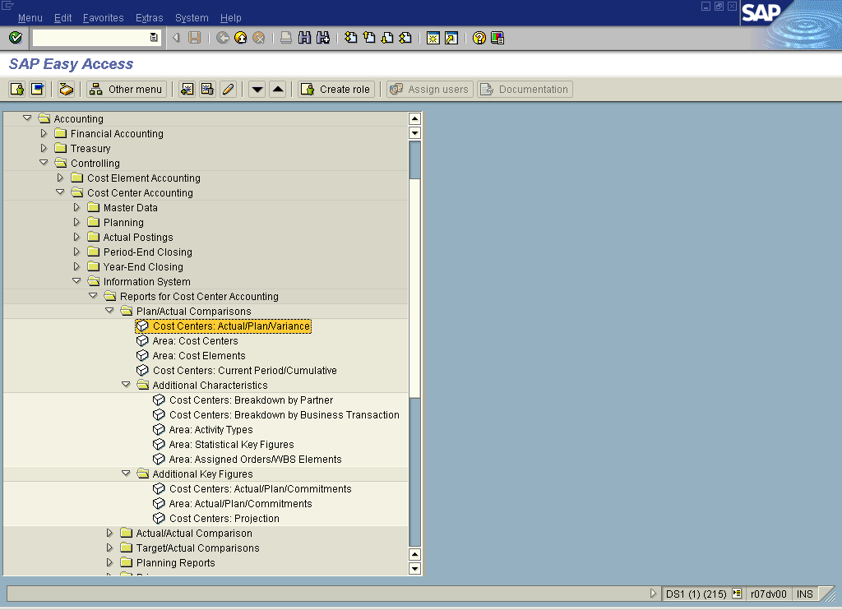
OCM Reporting Menu Path …

Slide 48
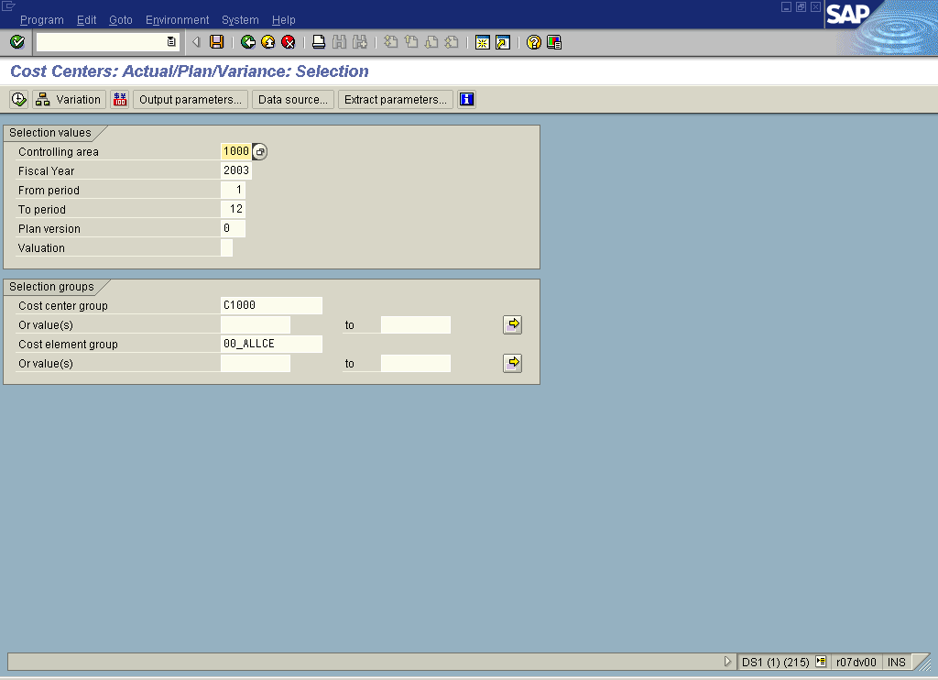
OCM Sample Report Selection Criteria …

Slide 49
Roles
SAP Overhead Cost Management

Slide 50
OCM Roles
Master Data Management
  Master data role is assigned to an individual who is responsible for changes and maintenance of OCM master data. This role is to be centralized. OCM Master Data are:
    Cost Center and Groups
    Cost Elements and Groups
Internal Orders Maintenance
  Internal order maintenance is assigned to an individual who is responsible for creation, changes and maintenance of internal order status

Slide 51
OCM Roles continued …
Plan Settings
  Plan setting maintenance is assigned to senior individual who is responsible for redefinition of plan version, maintain distribution keys etc
Primary Cost Planning
  Primary cost planning is assigned to an individual who is responsible for planning primary cost, copy from plan and actual, plan transfer from other modules and plan revaluation
Secondary Cost Planning
  Secondary cost planning is assigned to an individual who is responsible for planning cost allocation
Internal Order Budget Maintenance
  Order budget maintain is assigned to an individual who is responsible for the maintenance of new budget in-out, supplement. Transfer from other modules and plan revaluation

Slide 52
OCM Roles
Actual Postings
  Actual posting is assigned to individual who is responsible for the actual SKF data entry, posting manual entries, direct/indirect activity allocation and reservations
Allocation Settings Maintenance
  High level of individual who decide to Create or change allocation cycles in the system-Configuration process
Period / Year End Closing
  Period-end closing is assigned to individual who is responsible for carry on necessary cost reposting, distribution, allocation, settlement, FI/CO reconciliation and period look
Reporting Display
  Reporting is assigned to an individual who is trained to access, use, and interpret OCM reports

Slide 53
OCM Role to Process Mapping
Process Role | Master Data | Planning | Actual Posting | Period End Closing | Reporting
Master Data Maintenance | ✓
Internal Order Maintenance | ✓
Plan Settings |  | ✓
Primary Cost Planning |  | ✓
Secondary Cost Planning |  | ✓
Internal Order Budget Maintenance |  | ✓
Actual Postings |  |  | ✓
Allocation Setting Maintenance |  |  | ✓ | ✓
Period / Year End Reporting |  |  |  | ✓ | ✓
Reporting Display |  |  |  |  | ✓

